Slide 1
EPA & Anaerobic Digesters
April 18, 2024
Sharmin Syed
EPA Region 5 Agriculture Advisor

Slide 2
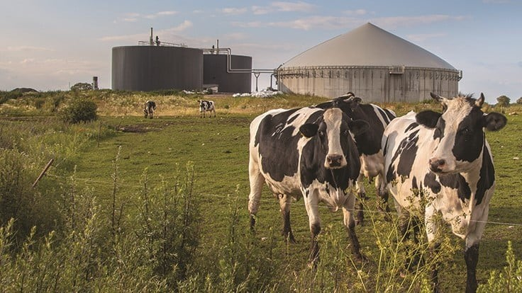
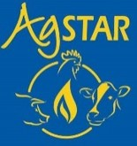
National Framework for Methane Mitigation
Overarching Strategies
  U.S. Methane Action Plan
  USDA Climate Smart Ag and Forestry Strategy
  Inflation Reduction Act
  Bipartisan Infrastructure Law
  Farm Bill
These national strategies discuss opportunities for supporting anaerobic digester systems on farms

Slide 3
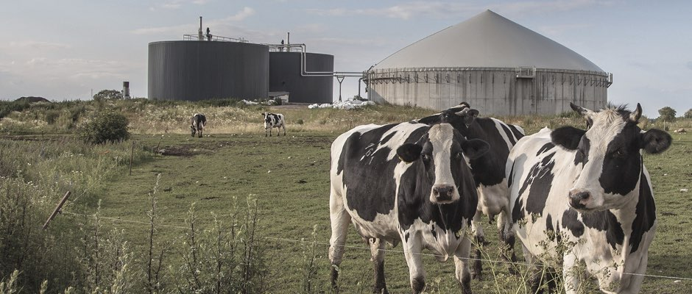
How AgSTAR Works
Partnership program
Collaborative program sponsored by EPA and USDA.
1
Promote Anaerobic Digestion
2
Strong Ties
3
Helping Hand
Working with industry, government, NGOs and university stakeholders.
Assisting those who enable, purchase, or implement farm anaerobic digestion projects.
Advancing economically and environmentally sound livestock manure management.

Slide 4
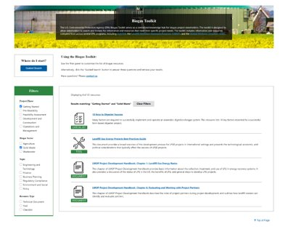
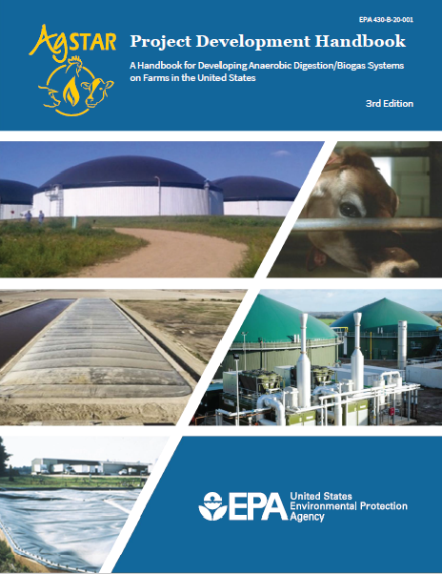
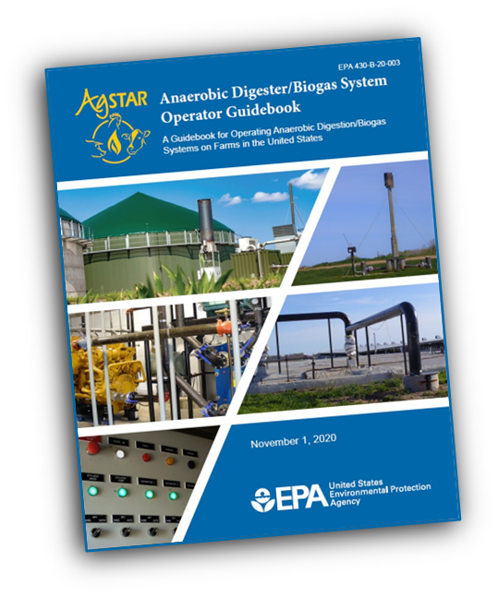
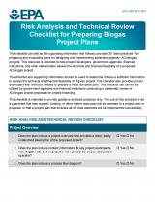
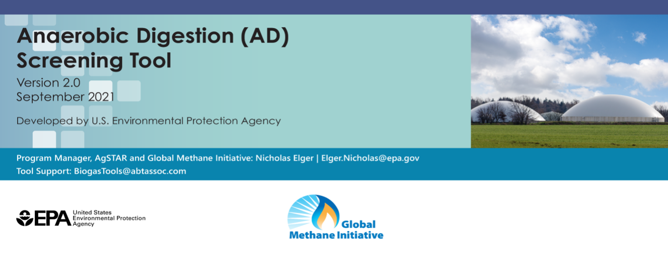
Foundational Resources for AD/ Biogas Systems
Biogas Toolkit:
  A web-based toolkit with 38 tools and resources to facilitate biogas project development.
Project Development Handbook (3rd Edition):
  A comprehensive compilation of the latest knowledge in the industry on best practices for anaerobic digestion (AD)/ biogas systems.
Operator Guidebook (1st Edition):
  A guide for AD/ biogas systems operators to ensure safe and efficient operations of the systems they manage.
AD Risk Analysis Checklist:
  A checklist of best practices to help users determine technical & financial feasibility of AD/ biogas projects.
AD Screening Tool:
  A Microsoft Excel-based screening tool to assess the potential feasibility
  of AD projects in the U.S. and globally.

Slide 5
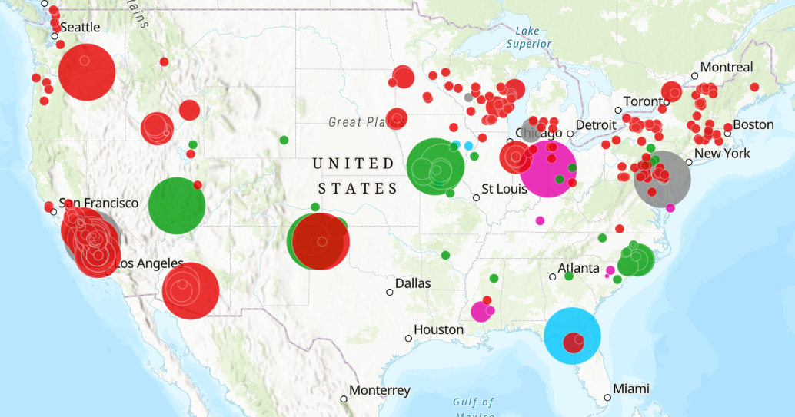
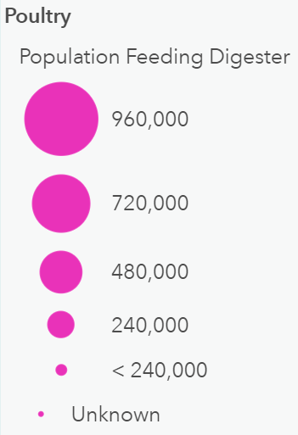
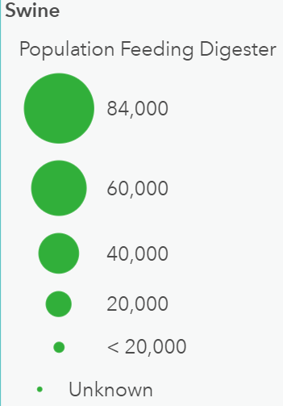
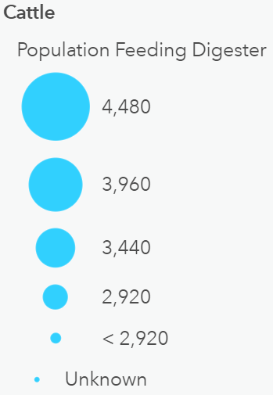
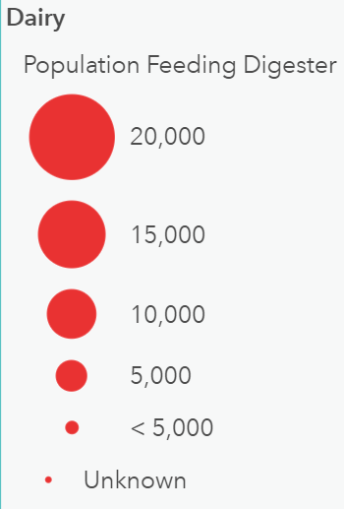
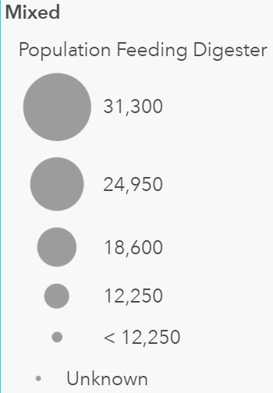
Where are digesters found on farms?
343 active digesters in the U.S. (as of Jan. 2023)
  290 Dairy
  46 Hog
  8 Poultry
  9 Beef
Note: Total exceeds 343 because some systems accept manure from more than one animal type.
104 (~30%) digesters combine manure with other feedstocks such as:
  Brewery/distillery spent grain
  Dairy processing wastes (e.g., whey)
  Food waste
  Agricultural residues

Slide 6
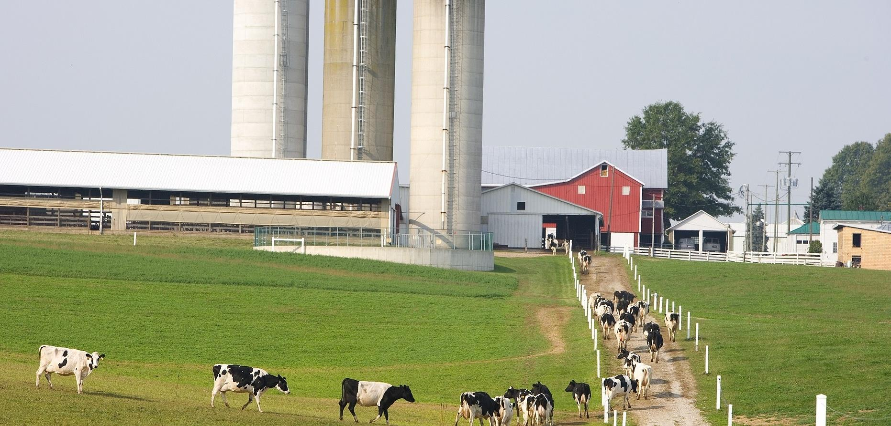
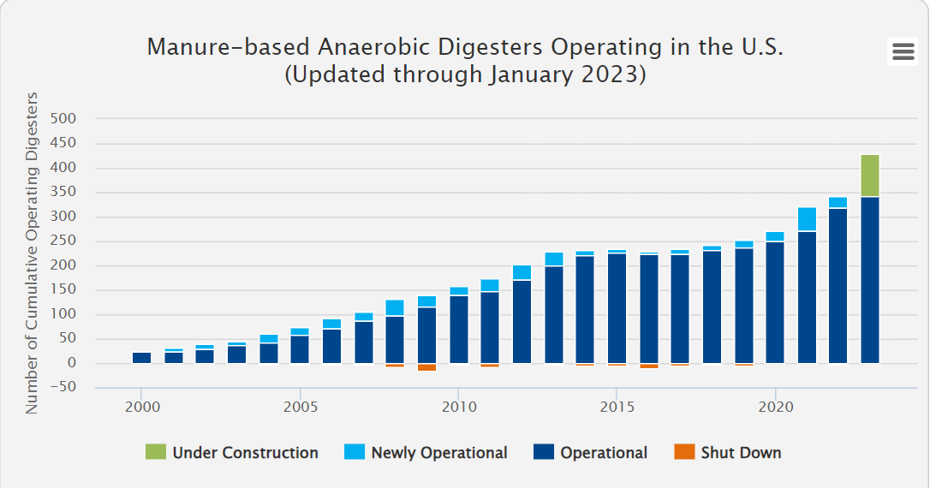

Farm Digester Market Growth
343
Current
Digesters
27 new AD systems came online in 2023
72 AD systems currently under construction
Source: AgSTAR Digester Database
Notes:
*Based on minimum farm size: 500 cows or 2000 pigs. AgSTAR’s Market Opportunities Report estimates that there is significant technical potential for AD over 8,000 systems on farms (managing manure) and many more possible in communities to manage food waste.
https://www.epa.gov/agstar/agstar-data-and-trends updated 5/2022

Slide 7
Opportunity for ADs in the U.S.
Potential for over 8,000 digesters on farms in U.S.
In 2019, EPA estimates that about 66 million tons of wasted food were generated in the food retail, food service, and residential sectors.
Most of this waste (about 60%) was sent to landfills.
Typical Characteristics for Profitable Biogas Recovery Systems
Animal Type | Manure Management Method | Size of Operation
Dairy | Flushed or scraped freestall barns or open lots | ≥ 500 head
Swine | Houses with flush, pit recharge, or pull-plug pit systems | ≥ 2,000 head

Slide 8
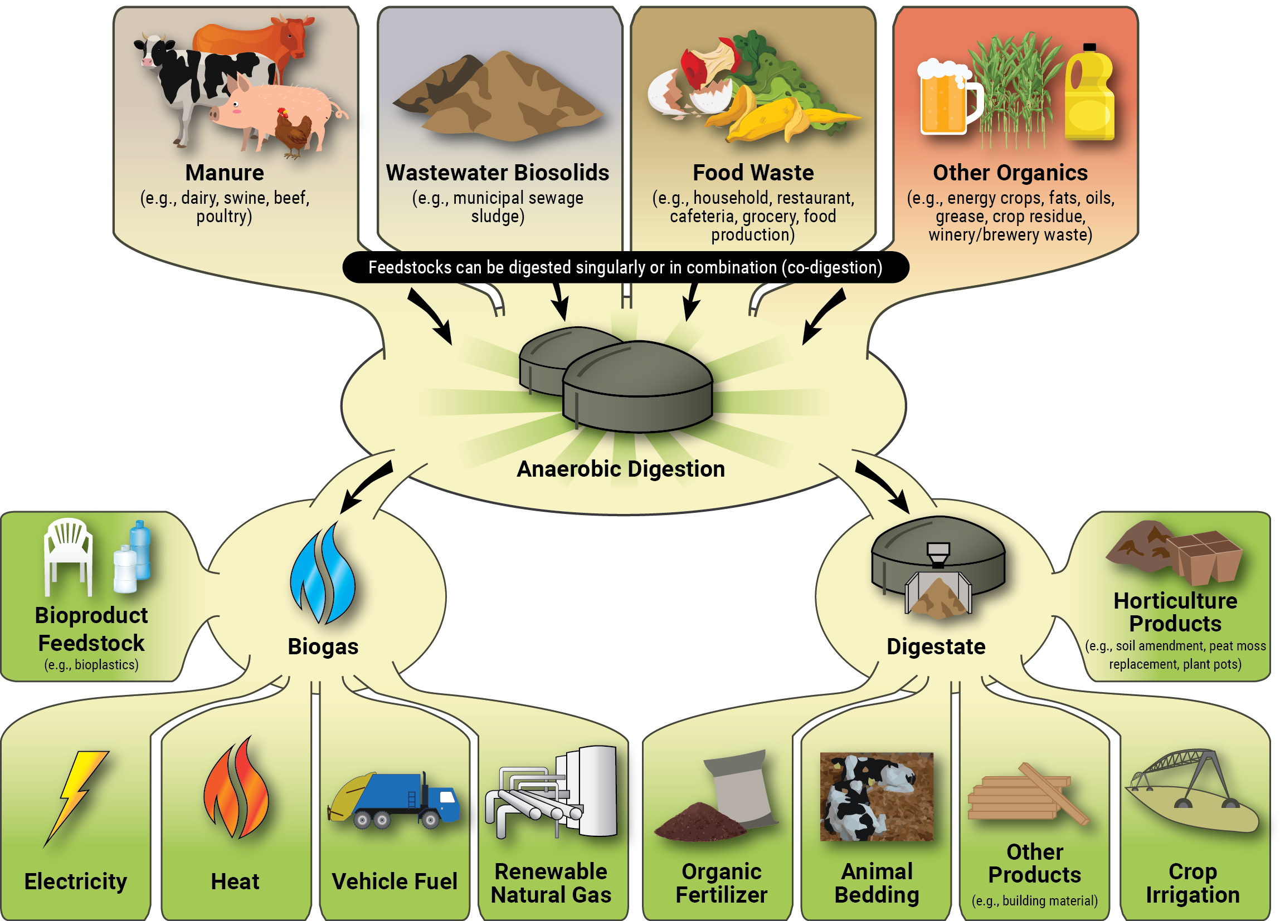
How does anaerobic
digestion
work?
Just add:
Organic Feedstock
Heat
Bacterial consortium
Time
And eliminate oxygen
Notes:
Anaerobic digestion (AD) uses bacteria to break down organic matter—such as animal manure, food wastes, wastewater biosolids—and generate two valuable products: biogas and digestate.
Biogas is comprised mostly of methane gas which can be used to produce energy: electricity; vehicle fuel (renewable natural gas (RNG)); heat barns; thermo-industrial
Digestate is the leftover solid and liquid portion of the manure which is nutrient rich and can be applied to soil to help grow crops and used as animal bedding.

Slide 9
Benefits of Anaerobic Digester Systems
Environmental
  Air Quality: reduced methane emissions, a powerful GHG and source of ground-level ozone; reduced odors
  Water Quality: reduced pathogens and excess nutrients from leaching into surface and groundwaters
  Soil Health: land application of digestate recycles nutrients and is shown to increase crop yields
Energy
  Renewable energy production; energy independence; and displacement of fossil fuels
Economic
  Diversified farm revenue through sale of energy and co-products; opportunity to create new local jobs; partnerships with local businesses
Anaerobic digesters are a tool to manage manure sustainably

Slide 11
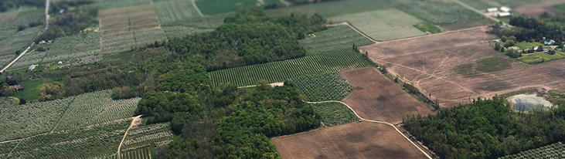
Contact:
Sharmin Syed
syed.sharmin@epa.gov
Connect:
www.epa.gov/agstar
Subscribe to our newsletter
Technical information and resources

Slide 12
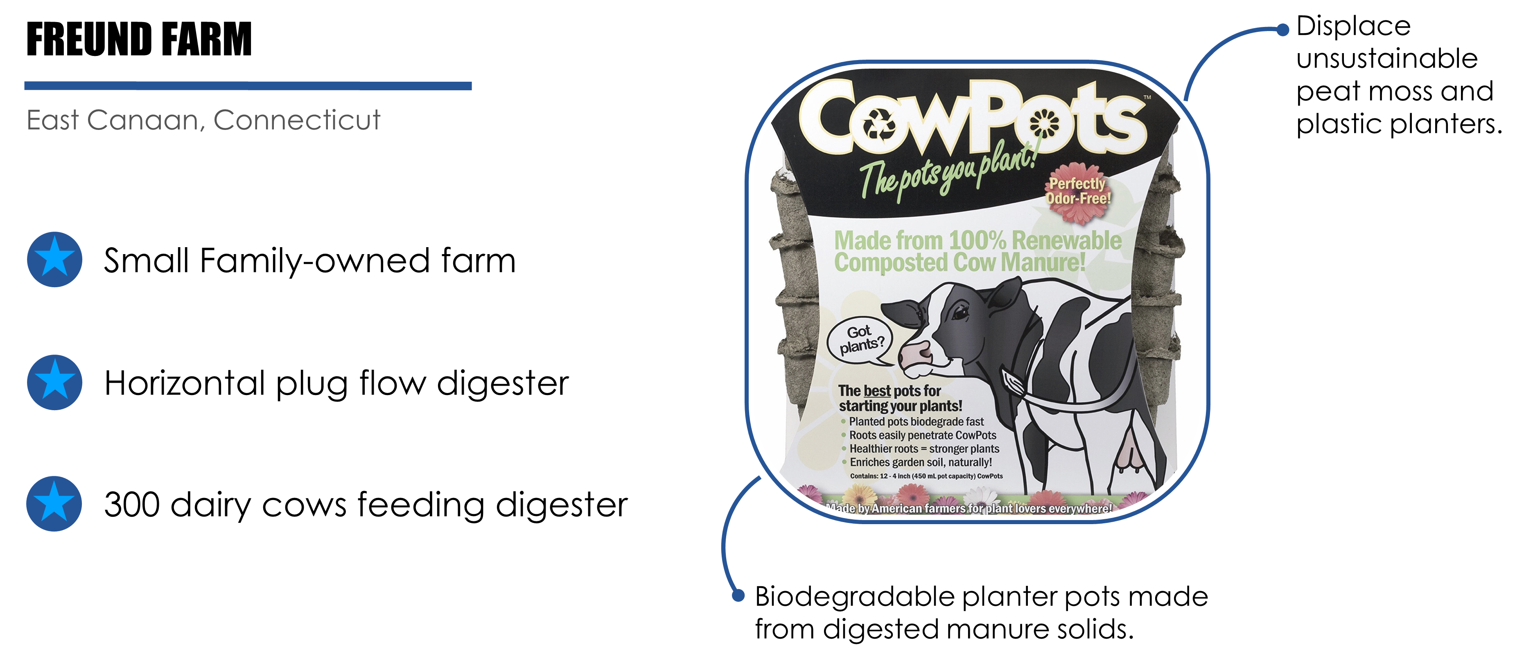
Project Example: Creating Value from Coproducts
Notes:
https://www.epa.gov/agstar/project-profile-freunds-farm-inc

Slide 13
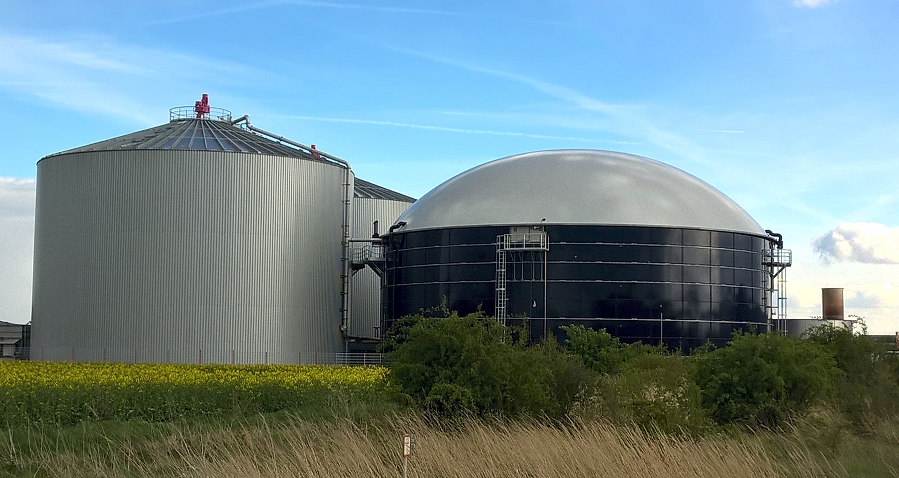
Decision-Support Tools for Anaerobic Digestion

Slide 14
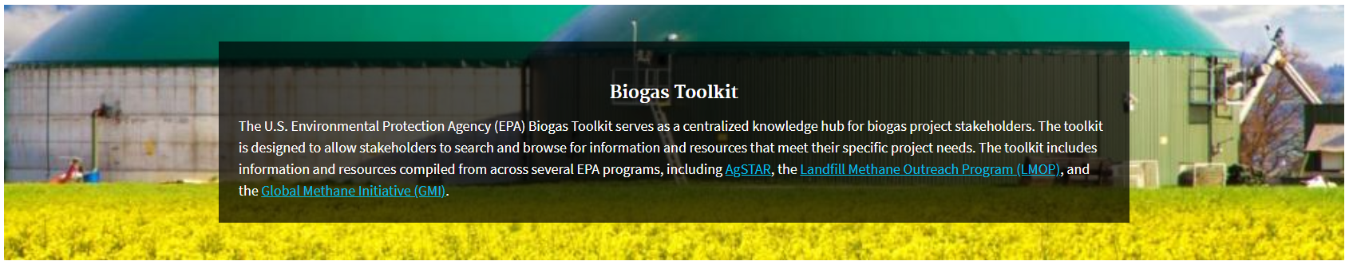
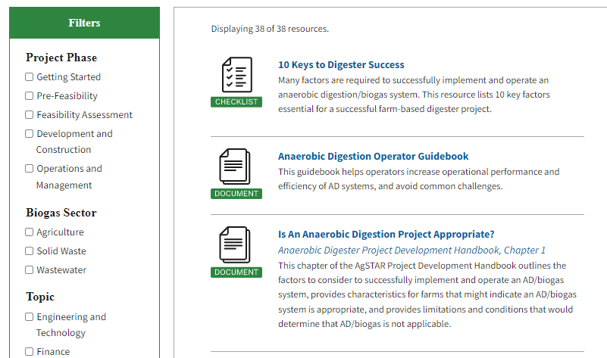
EPA Biogas Toolkit
EPA Biogas Toolkit includes 38 tools and resources to facilitate biogas project development.
Roadmap for planning and implementing biogas projects and quantifying economic and environmental impacts
Audience: Project implementers, developers, financiers, and policymakers.

Slide 15
AD Project Development Handbook
The latest knowledge in the industry on best practices for anaerobic digestion (AD)/ biogas systems.
Goal: ensure long-term success for AD/ biogas systems by providing a framework for project development.
Primary audience: Anyone interested in AD/biogas systems as a farm manure management option
  Policy makers
  Farmers
  Financiers/ investors
  Private Developers
Notes:
This is a comprehensive handbook that is intended for anyone working in agriculture or renewable energy and is interested in ADs or biogas. The PDH outline the necessary development steps and outstanding questions that developers must answer during the evaluation and development of a farm-based AD system.

Slide 16
Handbook Overview
11 Chapters that outline key considerations for farm-based digester projects
  Process Fundamentals
  Digester Feedstocks
  Products and Equipment - Energy and Digestate
  Economic and Financial Factors
  Screening and Feasibility Assessments
  Business Relationships
  Permitting
  Public and Community Outreach
  Safety, Operations and Maintenance
Notes:
There are 11 chapters in the PDH on a wide scope of topics. It is meant to be used as a resource and as needed.

Slide 17
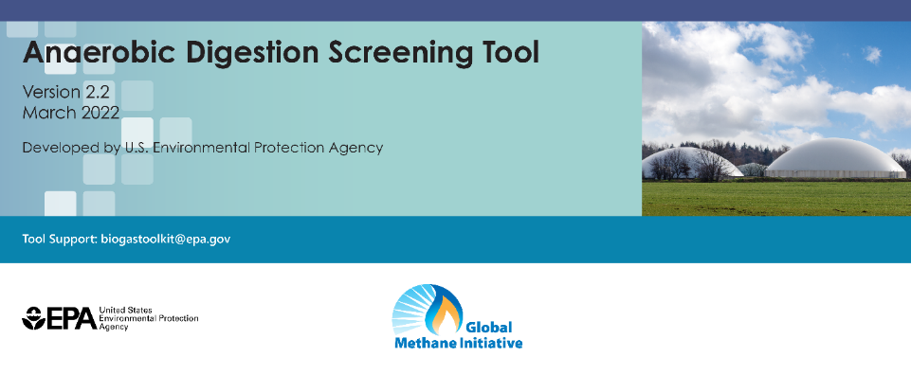
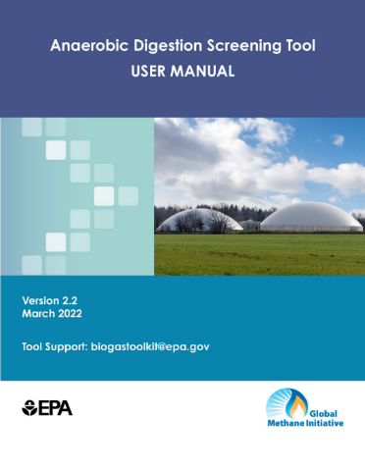

Anaerobic Digestion (AD) Screening Tool
Excel-based screening tool to assess potential feasibility of an anaerobic digestion project. The tool outputs include:
  Annual biogas and digestate generation
  Methane emissions reductions projections
  Potential end uses of biogas
Primary audience:
  Project proponents to understand the biogas potential of a proposed project
  Lending institutions/banks to determine if a project application is feasible
Visit GMI’s Tools and Resources Library to download the tool: https://www.globalmethane.org/resources
Notes:
The Anaerobic Digestion Screening Tool is an Excel-based tool that enables users to conduct pre-feasibility analyses to evaluate AD opportunities for a variety of feedstocks, including organic municipal solid waste, livestock manure, agricultural residues, and wastewater. The tool generates the following outputs:
Annual biogas and digestate production
Project methane emission reductions
Potential end uses of biogas, including estimates for electricity production, natural gas production, cooking gas potential, and home heating potential
This tool is intended to help project developers, government agencies, financial institutions, and other stakeholders conduct an initial screening assessment of the technical and financial feasibility of proposed AD projects.

Slide 18
Policies and Incentives for Anaerobic Digester Systems

Slide 19
State and Local Policy Mechanisms to Support AD Adoption
Grants and Loans
  Grant and loan programs can be funded through various state agencies, including environmental, economic development, and rural development/agriculture
  States can also encourage AD adoption through utility rebate programs
Program Examples
  The Pennsylvania Alternative and Clean Energy Program (ACE) provides loans and grants for clean energy generation projects
    Project grants cover up to $2 million or 30% of project cost
    Feasibility and planning grants cover up to $175,000 or 50% of cost
  Since 2014, Wisconsin Focus on Energy (FOE) has provided up to $15,000 of cost for feasibility studies for biogas projects
Notes:
- FOE is funded by a partnership of 107 utilities throughout Wisconsin

Slide 20
State and Local Policy Mechanisms to Support AD Adoption
Performance-Based Incentives
  States with performance-based incentives typically offer $0.015 to $0.1 per kWh produced
  Performance-based incentives can be made available to a wide range of capacities so that farms of different sizes can participate
Program Example
  In 2014, Rhode Island passed a bill to create the Renewable Energy Growth (REG) program
    Tariff-based incentive program designed to finance development, construction, and operation of renewable energy projects to achieve specified megawatt (MW) targets
    In 2023, AD systems can receive up to $0.19/kWh for 20 years

Slide 21
State and Local Policy Mechanisms to Support AD Adoption
Low Carbon Fuel Standard (LCFS)
  State-level initiative to reduce carbon intensity of transportation fuels
  Biogas processed into compressed renewable natural gas for use as vehicle fuel qualifies as a "low-carbon fuel"
  Biogas projects generate credits which can be sold or traded in the carbon market
  California and Oregon have implemented LCFS programs
Collaborative outreach program sponsored by EPA and USDA

Slide 22
State and Local Policy Mechanisms to Support AD Adoption
Renewable Portfolio Standard (RPS)
  Renewable Portfolio Standards (RPS) are policies that set requirements to increase the use of renewable energy sources for state electricity generation
  Majority of states have enforceable or voluntary RPS
    not all RPS allow energy generation from AD systems
  RPS do not directly provide financial incentives to AD system operators
    To meet RPS requirements, utilities may develop rebate programs for AD systems
Policy Examples
  In 2008, Michigan enacted the Clean, Renewable, and Efficiency Energy Act, which requires all state electricity providers to meet tiered RPS requirements with 60% renewables by 2035
  In 2021, the Illinois Climate and Equitable Jobs Act, increased state RPS requirements to 50% renewable energy by 2040

Slide 23
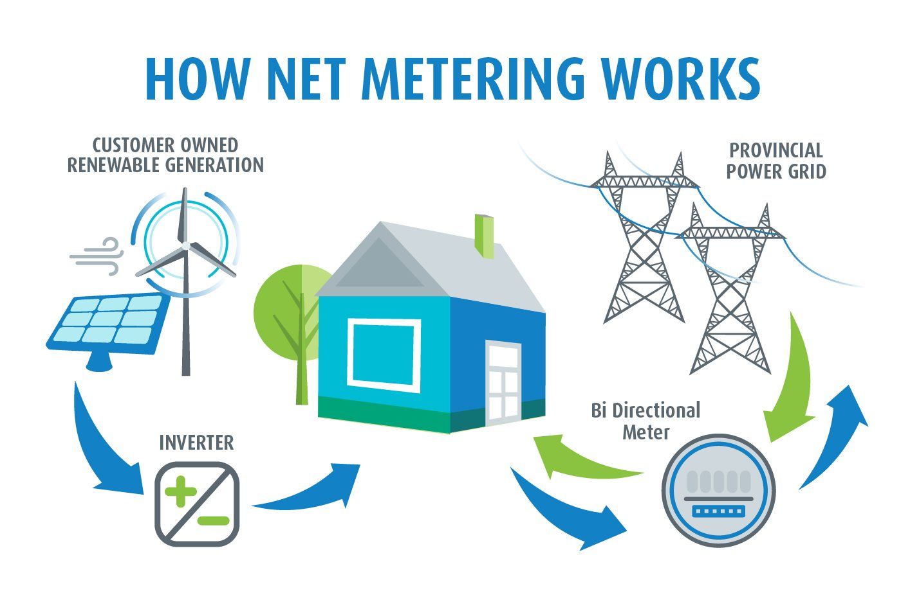
State and Local Policy Mechanisms to Support AD Adoption
Net Metering and Feed-in-Tariffs
  Allow electricity producers to sell excess electricity to the grid at a fixed or variable price
  As of 2021, 41 states and Washington, D.C. have adopted net metering policies
  Feed-in-Tariffs with fixed terms allow farms to have consistent revenue stream over project lifetime
    Very useful for project planning and feasibility
Program Example
  Northern Indiana Public Service Company customers can sell electricity generated by AD back to utility for $0.092/kWh over a 15-year term
Notes:
Sources:
- A Global Perspective of Anaerobic Digestion Policies and Incentives (globalmethane.org)
Sustainability | Free Full-Text | How Incentives Affect the Adoption of Anaerobic Digesters in the United States (mdpi.com)

Slide 24
State and Local Policy Mechanisms to Support AD Adoption
Tax Credits and Incentives
  Corporate, personal, sales, and property tax incentives can be used to directly reduce an individual biogas producer’s tax bill
  Options vary by state but include allocating tax credits based on kilowatts per hour (kWh) produced, allocating tax credits worth a percentage of the property constructed, or offering reduced tax liability
Program Examples
  The Utah State Energy Program provides tax credits for both residential and commercial renewable energy systems
    For commercial AD systems, the tax credit is $0.0035/kWh for a 4-year term
  The Michigan Department of Agriculture provides 100% exemption from real and personal property taxes for qualifying farm AD systems
Notes:
Tax Incentives: For example, Iowa allocates tax credits worth $0.015 per kwh for ten years, while North Carolina allocates credits worth 35% of the property constructed.
Sources:
- A Global Perspective of Anaerobic Digestion Policies and Incentives (globalmethane.org)
Sustainability | Free Full-Text | How Incentives Affect the Adoption of Anaerobic Digesters in the United States (mdpi.com)

Slide 25
State and Local Policy Mechanisms to Support AD Adoption
Organics Diversion Policies
  States implement organic waste diversion policies to reduce food and yard waste from going to landfills
  These policies provide a reliable source of waste that can be added to farm AD systems (known as co-digestion) to increase biogas production and revenue
Program Examples
Massachusetts regulations ban disposal of food and other organic wastes from businesses and institutions that generate more than one-half ton of these materials per week
From 2012 to 2020, the Commonwealth Organics-to-Energy Program helped prepare the state for the impending ban by providing grant funding for feasibility studies and construction of AD systems that combine food waste and manure
  12 facilities were constructed or upgraded for a 500,000-tons-per-year increase in state organics processing capacity
  The program established a business model of economically viable co-digestion AD systems on modestly-sized farms

Slide 26
Technical Assistance to Support Anaerobic Digestion
Anaerobic Digester Ombudsman
  A third-party individual that helps livestock facilities develop and maintain anaerobic digester projects.
  In New York and Vermont, AD ombudsman programs supported development of over 40 anaerobic digestion projects.
“I cannot overstate the fact that without [the ombudsman] I wouldn’t have my anaerobic digester. I would have been too overwhelmed with the process. [The ombudsman] provided guidance that was vital to getting my anaerobic digester.”
– Reg Chaput, Chaput Family Farms

Slide 27
California Manure Management Grant program
CDFA’s Alternative Manure Management Program (AMMP) provides financial assistance for the implementation of non-digester manure management practices in California.
  DFA awarded 31 projects for the 2023 AMMP solicitation, totaling $21.41 million in grant funding.
AMMP practices include solid separation and conversion from flush to scrape followed by some form of drying or composting of collected manure, pasture-based management, and alternative manure treatment and storage.
AMMP is estimated to reduce greenhouse gas emissions by 1.1 million metric tons of CO2e over 5 years

Slide 28
Evaluating State Policy & Incentives Impact on AD Adoption
Several studies have evaluated the influence of state policies and programs on AD adoption
  Most effective: RPS, performance-based incentives, and other state mandates to increase consumption and purchase of renewable energy
    Performance-based incentives especially critical for AD; Fixed rate, fixed term provides certainty
  Most effective for smaller farms: grants and loans to subsidize development costs; lack of access to capital is major barrier
  Most effective for GHG reductions: carbon pricing policy not tied to energy production provides the greatest social benefits
  Less effective: net metering and interconnection
Sources: University of Florida (2017); USDA (2012)
Notes:
Sources:
- Sustainability | Free Full-Text | How Incentives Affect the Adoption of Anaerobic Digesters in the United States (mdpi.com)
USDA ERS - Alternative Policies To Promote Anaerobic Digesters Produce Positive Net Benefits

